Slide 1
टुलकिट कसरी प्रयोग गर्ने

Slide 2
तालिम किट
प्रयोग गर्दा सबै निर्देशनहरू पढ्नुहोस्
किट सामग्रीहरूले एक अर्कालाई पूरा गर्छन् र समर्थन गर्छन्
सहजकर्ता निर्देशकद्वारा समर्थित प्रस्तुतीकरण
प्रशिक्षकद्वारा लिइनुपर्ने उद्देश्यहरू र FG मा स्व-आँकलन
पाँचको गोजी पुस्तिका प्रस्तुतीकरणमा FLW को लागि सन्दर्भ सामग्री हो
1

Slide 3
तालिम किटका विषयहरू
स्पिकर नोटसहित प्रस्तुतीकरण
प्रस्तुतीकरणमा मद्दत गर्न सहजकर्ता निर्देशिका
पाँचको गोजी पुस्तिका तालिममा प्रयोग गर्न ANM/ASHA लाई मद्दत गर्ने सन्दर्भ हो
2
Notes:
The name of the disease is COVID-19. THIS IS CORONA VIRUS DISEASE – discovered in 2019. The name of the organism that causes the disease is SARS-CoV-2. This stands for Severe (because it is serious) Acute Respiratory Syndrome- Coronavirus (the name of the family of viruses) 2. Coronaviruses cause several similar diseases including SARS, HINI (Swine flu) and the common cold and Influenza.
Symptoms of COVID-19 are fever, cough and difficulty in breathing
If a person sees these symptoms, the person must immediately contact the government helpline numbers given in this slide.
If you know that the person with whom you have been in contact has been identified as positive for COVID-19, then the person must contact on the helpline numbers immediately.

Slide 4
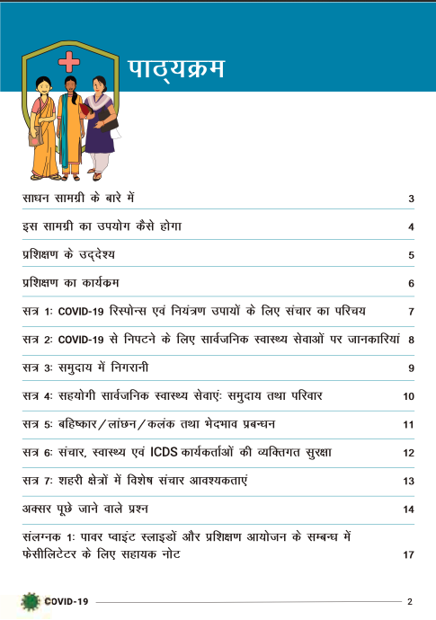
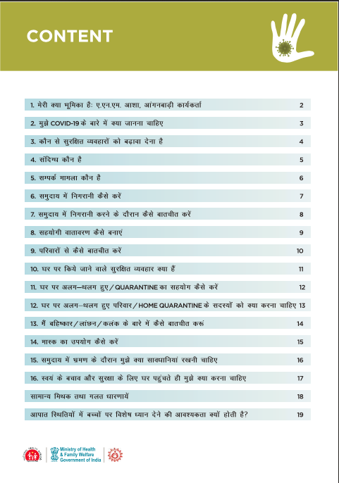
सहजकर्ता निर्देशिका
गोजी पुस्तिका
विषयसूची
3

Slide 5
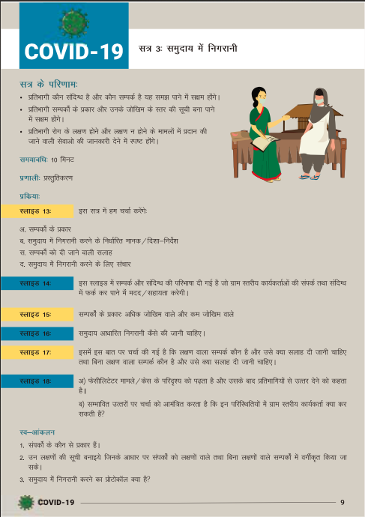
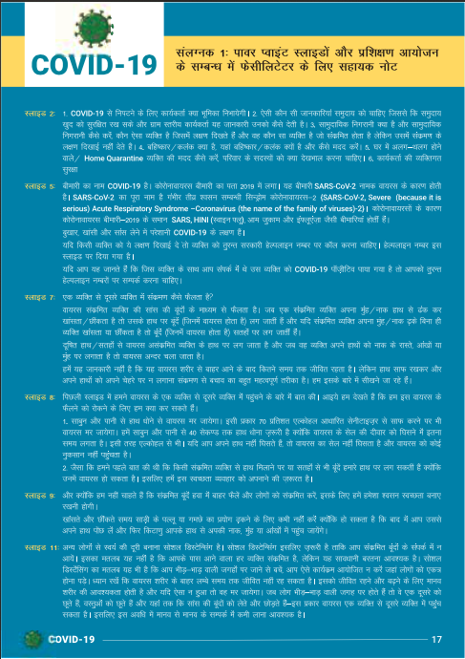
सहजकर्ता निर्देशिकाको प्रयोग कसरी गर्ने
प्रत्येक सत्रअघि सिकाइ प्रतिफलहरू सहभागीहरूलाई बयान गर्नुपर्छ
स्लाइडहरूले तपाईँलाई स्लाइडको बारेमा संक्षिप्तमा व्याख्या गर्नेछन्
सत्रको अन्त्यमा सहभागीहरूले इनपुट प्राप्त गरेका छन् भनी तपाईँलाई बुझ्न मद्दत गर्न उनीहरूको साथमा स्वआँकलन गरिनुपर्छ
महत्त्वपूर्ण स्लाइडहरूका लागि प्रशिक्षक नोटहरू सहज सन्दर्भको लागि यहाँ दिइएका छन्
4

Slide 6
प्रस्तुतीकरणको प्रयोग कसरी गर्ने
स्लाइडहरूको समग्र प्रयोग बुझ्नको लागि सहजकर्ता निर्देशिका पर्योग गर्नुहोस्
महत्त्वपूर्ण स्लाइडहरूमा प्रशिक्षकको लागि स्लाइडहरूको बयान गर्न स्पिकर नोटहरू छन्
प्रत्येक सत्रको अन्त्यमा सत्रको बुझाई जाँच गर्न सहजकर्ता निर्देशिकाबाट स्व-आँकलन प्रयोग गर्नुहोस्
5

Slide 7
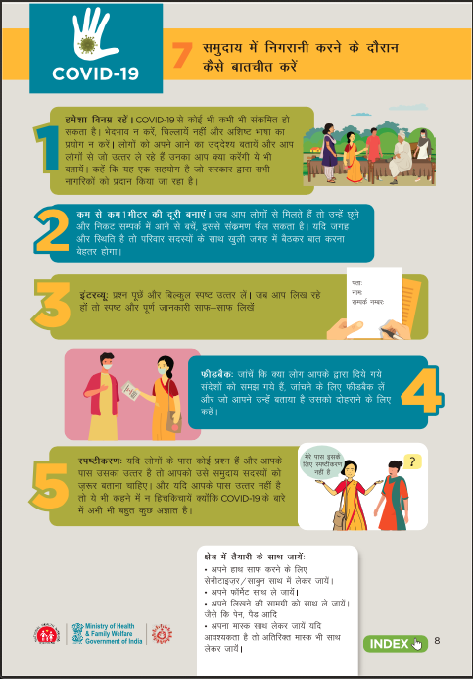
पाँचको गोजी पुस्तिका कसरी प्रयोग गर्ने
FLW द्वारा फोनमा प्रयोग गरिने
सम्झनुपर्ने पाँच कुराहरू
सूचकलाई पृष्ठमा नेभिगेट गर्न सकिन्छ
FLW को लागि हाते सन्दर्भ
कसरी गर्ने भन्नेमा पाँच महत्त्वपूर्ण बुँदाहरू
6

Slide 8
अप्रत्यक्ष तालिम प्रोटोकलहरू
केन्द्रित हुनुहोस्
आफ्नो आवाजलाई सन्तुलित राख्नुहोस्
सम्भव भएसम्म धेरै प्रशिक्षार्थीहरूसँग अन्तरक्रिया गर्नुहोस्
छलफल र Q/A को लागि प्रोटोकलहरू सेट गर्नुहोस्
सहभागीहरूलाई उनीहरू बोल्न सुरु गर्नुअघि आफ्ना क्यामेराहरू बन्द गर्न भन्नुहोस्
कहाँ लगइन गर्ने भन्नेमा सबै जना सचेत छन्
जडान गर्नको लागि विशिष्ट व्यक्तिलाई सन्देश दिइन्छ
राम्रो इन्टरनेट जडान
सत्रको लागि समय
दर्ता
7
Notes:
Make sure your internet connection is good enough. Video teleconferencing training is conducted via the Internet, only a well-connected network can make a video conferencing training become a reality.
Well equip your training room. Before you begin a training class, you need to well equip your room with video conferencing equipment. Your trainees are spread over a large area . What you require is a PC, a webcam and a microphone speaker, and then you can start to lecture on the Internet by utilizing a greatvideo teleconferencing software like ezTalks Meetings.
In another circumstance, you have both students in the training room and other different places, and you have to give a lecture to all of them. At this time, you need to prepare more video teleconferencing equipment for the room, like external cameras and loudspeakers, gooseneck microphones for students to have a brainstorm, etc.
#3 Be familiar with video conferencing software. As a trainer, you need to be very familiar with the video conferencing tool before the training course, so that you might not waste time on some operational problems and thus increase the productivity.
Although it is conducted on the Internet, you should still be well dressed like what you did on the site. Make yourself look like a professional trainer, so that trainees might be more willing to believe you. Of course, what you lecture is of vital importance for students, so made elaborate preparations for your training content and focused on the training, because you are exposed in the camera.
Videoconferencing students, especially if they are remote, tend to sit back in a passive mode, which is not helpful to their learning at all. As a teacher, remember to have interactions with students as many as possible. Ask questions via chat or audio, create a poll, offer related resources and create other means of interactions.
It is necessary for both the trainer and trainees to have a good environment. If some students speak something loud or there are some noises from them when you are lecturing or one student is answering the question, you could mute them through the video conferencing software.

